Slide 1

AR Journey Into Movies
Liwa Tang, Zhihao Cai,
Junyi Huang, Yiwei Pang
Supervisor: Xudong Jiang

Slide 2
Pipeline
Current Process
Next steps
Localization:
Database (SfM construction)
Algorithm:
Record uploaded frames info in Session world
Localize corresponding poses in SfM world
SfM <->Session transformation: s, R, t.
Convert movie camera pose to Session world
intergration
Navigation
Real Movie Scene
User test
Visualization (Unity):
• AR scene setup (ARFoundation)
• Real-time localization visualization
• Guidance and navigation arrow
• Frustum visualization for movie camera
Notes:
Localization:
1.construct the sfm model of CAB building as a demo.
2.Algorithm: record uploaded frames session coordinates and intrics of the user camera view > using HLOC to locaolize the frames poses in SfM world > compute the transformation matrix between Sfm and session using coordinates pairs. > convert movie.....and return to the software terminal.
3.challenge: computation time of localization is a bit long > currently exploring the pre-matching function to improve it.
The Unity module receives the estimated camera pose and transformation parameters from the server,​
and then using ARFoundation together with a 3D frustum visualization to represent the localized camera,​
and a UI layer to display real-time feedback and navigation hints.
Next these two parts will be integrated, transforming the offline camera poses into the AR session coordinates,
enabling real-time visualization of localization results and navigation guidance inside the app.

Slide 3
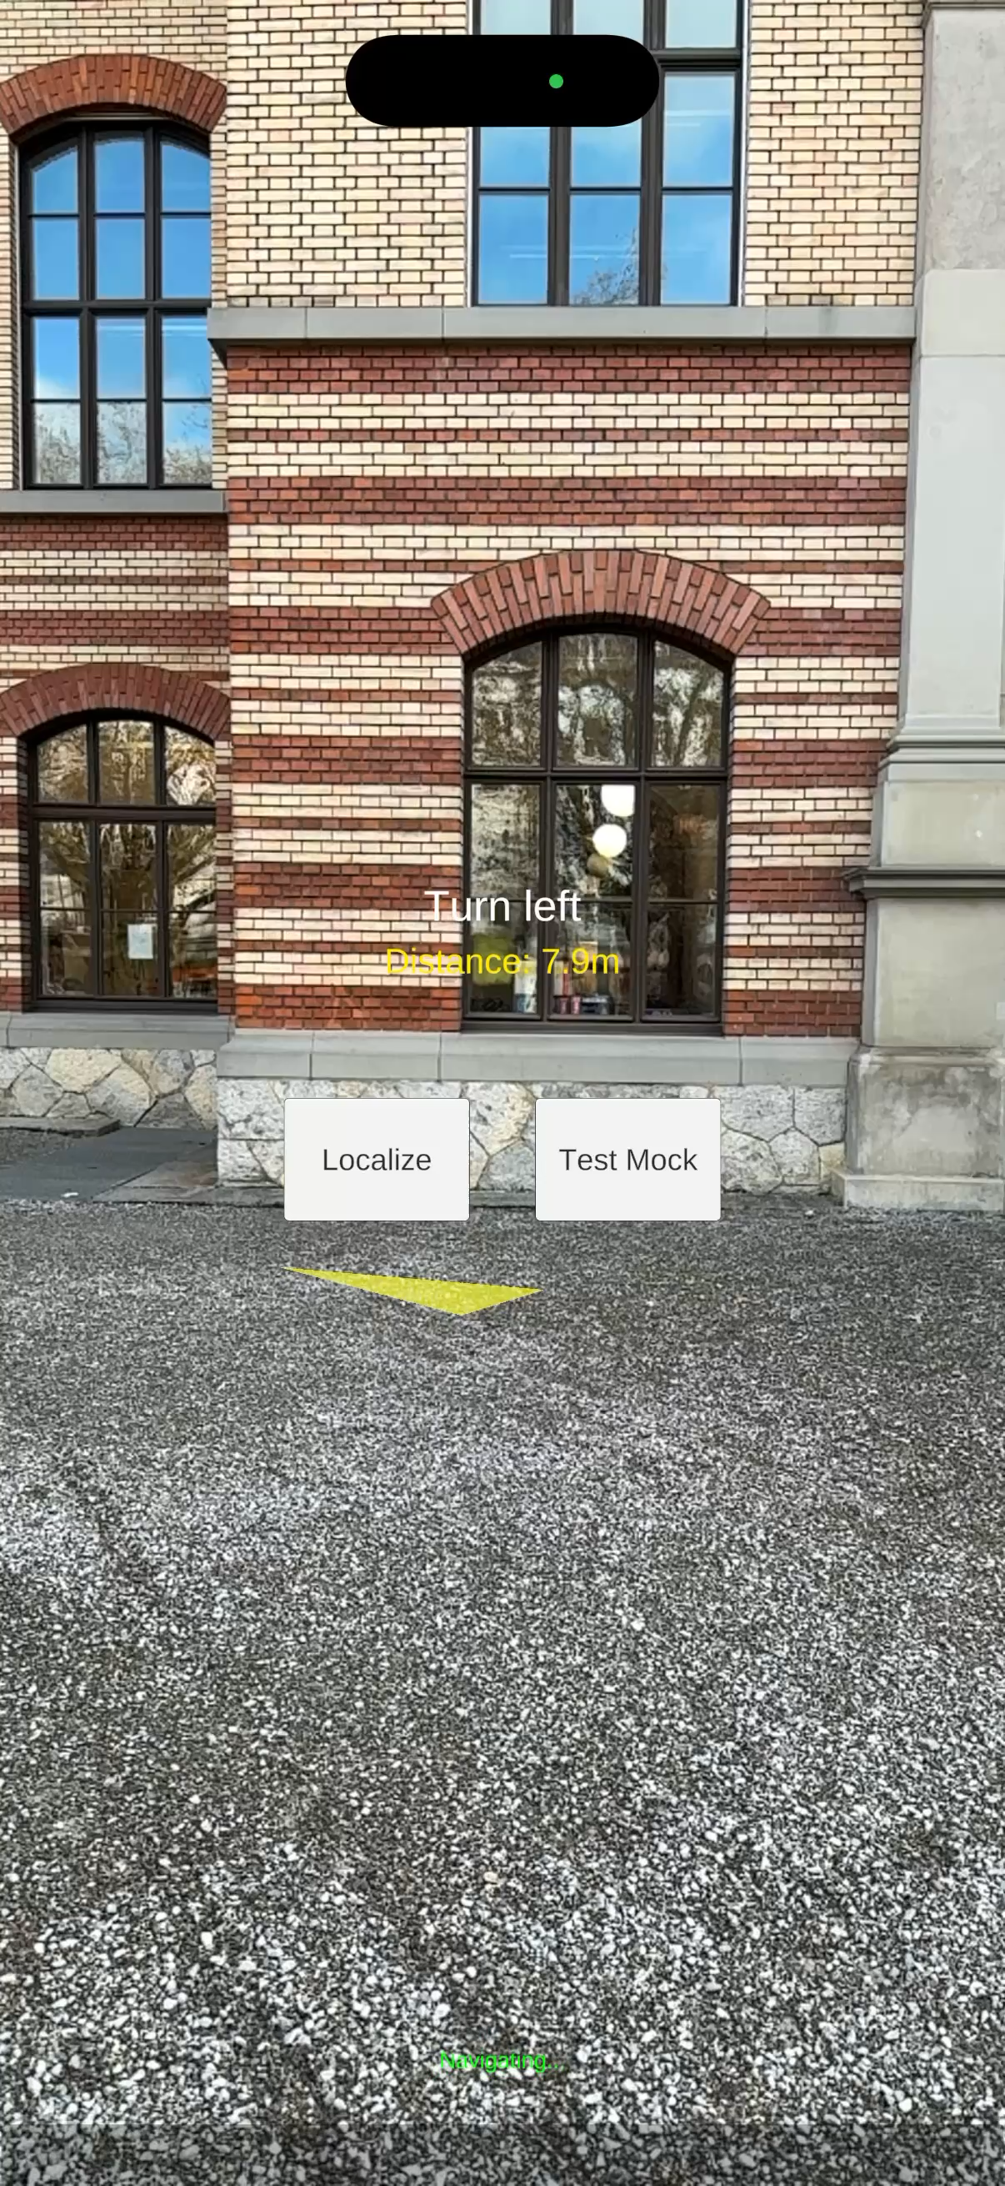
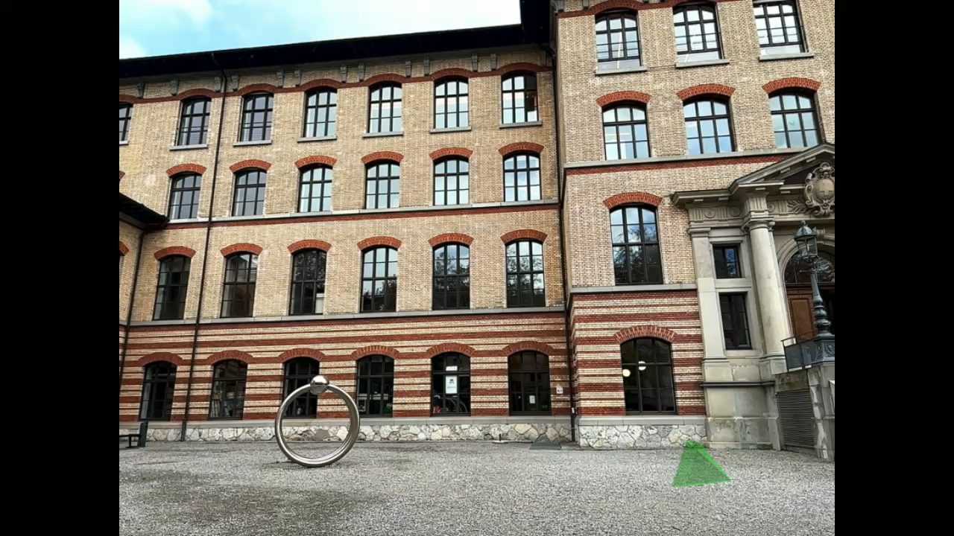
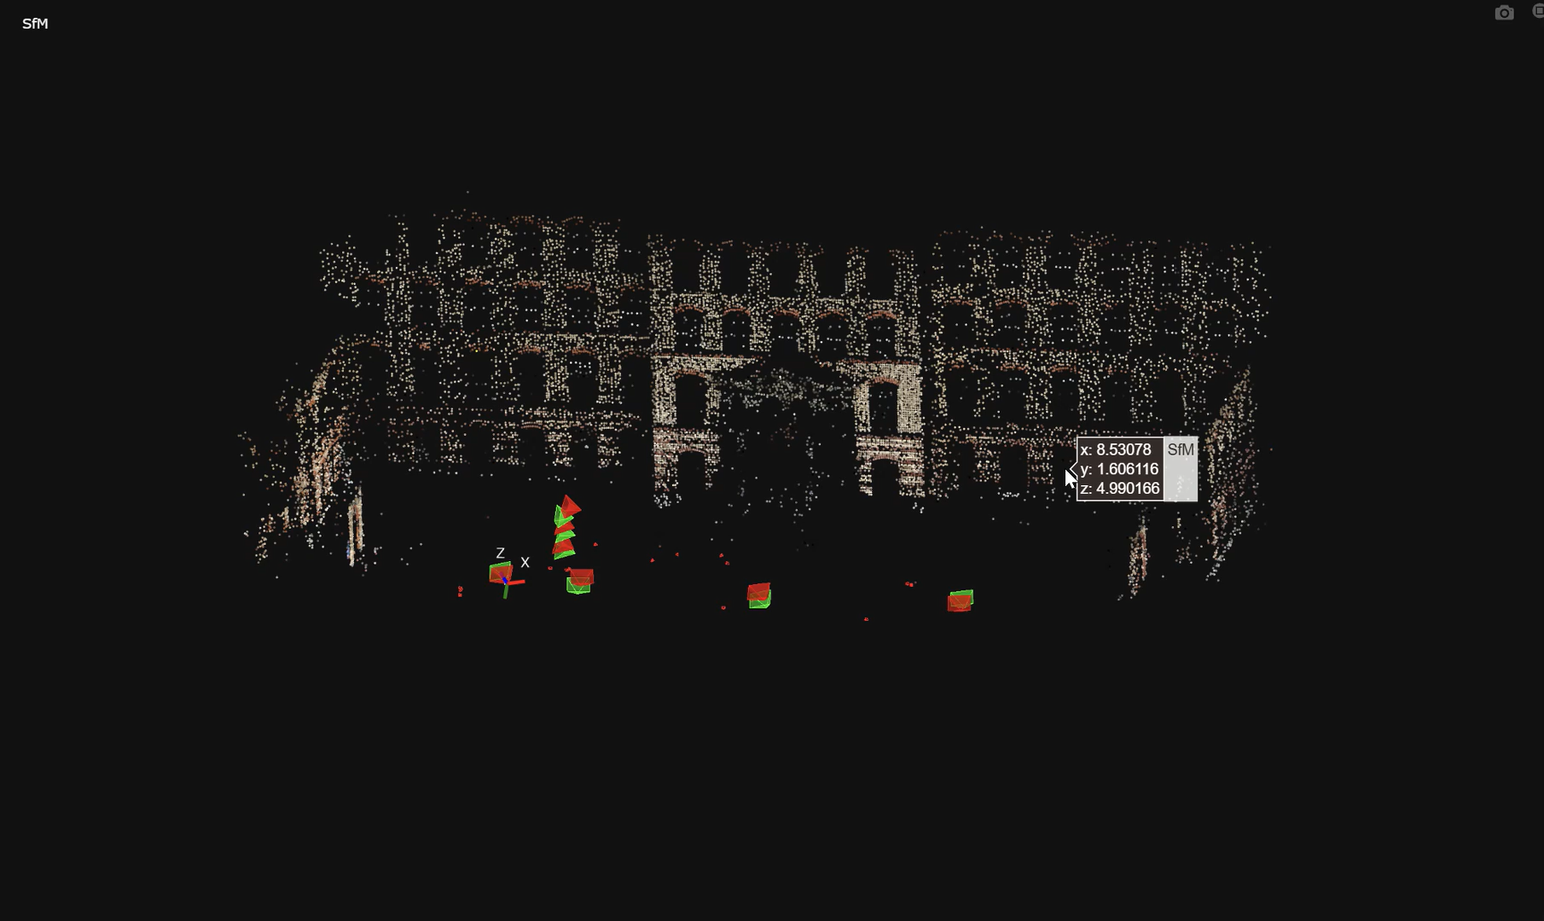
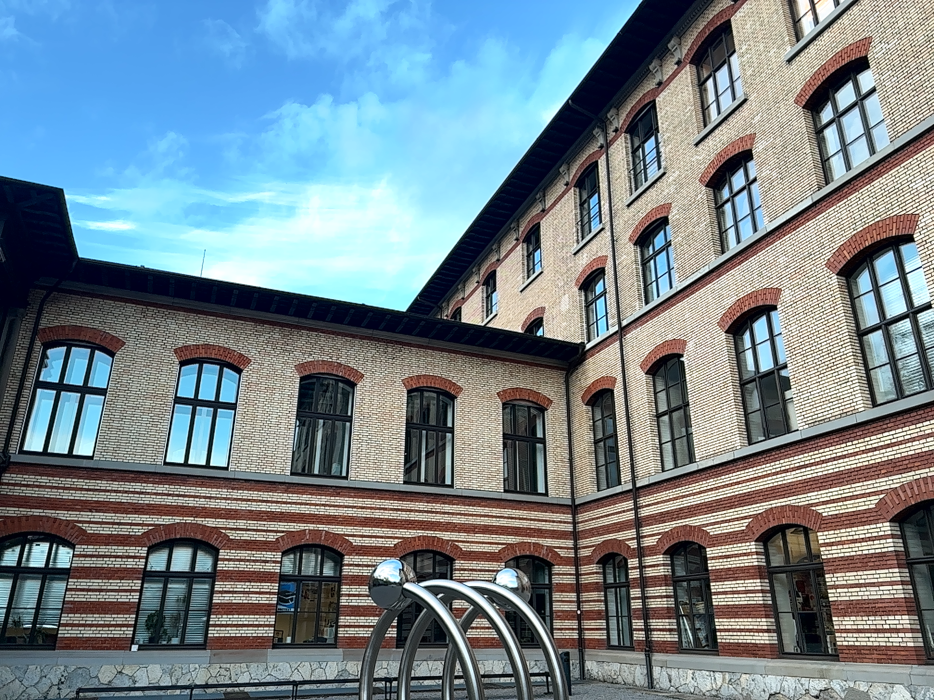
Present Results
Localization:
Load: prepared SfM and a mocked movie frame.
Import: frames captured from camera view in the appand corresponding poses in the AR session.
Localize the poses of frames and perform coordinatestransformation.
Output: mocked movie frame’s poses in the ARsession.
Visualization (Unity):
Initialize AR scene with ARFoundation (AR Session, XR Origin, Camera).
Localizing target with a 3D frustum model.
Provide interface showing distance, hints and status.
Enable navigation visualization (arrow + text guidance).
Notes:
Visualization results:
Localization:
1.Load 2.Import
3.Complement the localize algorithm: include poses localization and coordinates transformation.
The video shows the accuracy of our localization algorithm, (In the sfm world) the poses we got from localization algorithm are approximately overlayed with the poses exported from ARCore, indicating the effectiveness of our algorithm.
4.The output is the mocked movie frame’s poses in the AR session. The video shows the effect of our outputted pose projection onto the user's camera view. The position is consistent with where we took the mocked movie frame.
The Unity module visualizes localization results using ARFoundation.​
It displays the localized target as a 3D frustum model. ​
A simple UI shows distance and direction, while arrow and text guidance help users align their view to the movie camera’s position in the real world.​

Slide 4
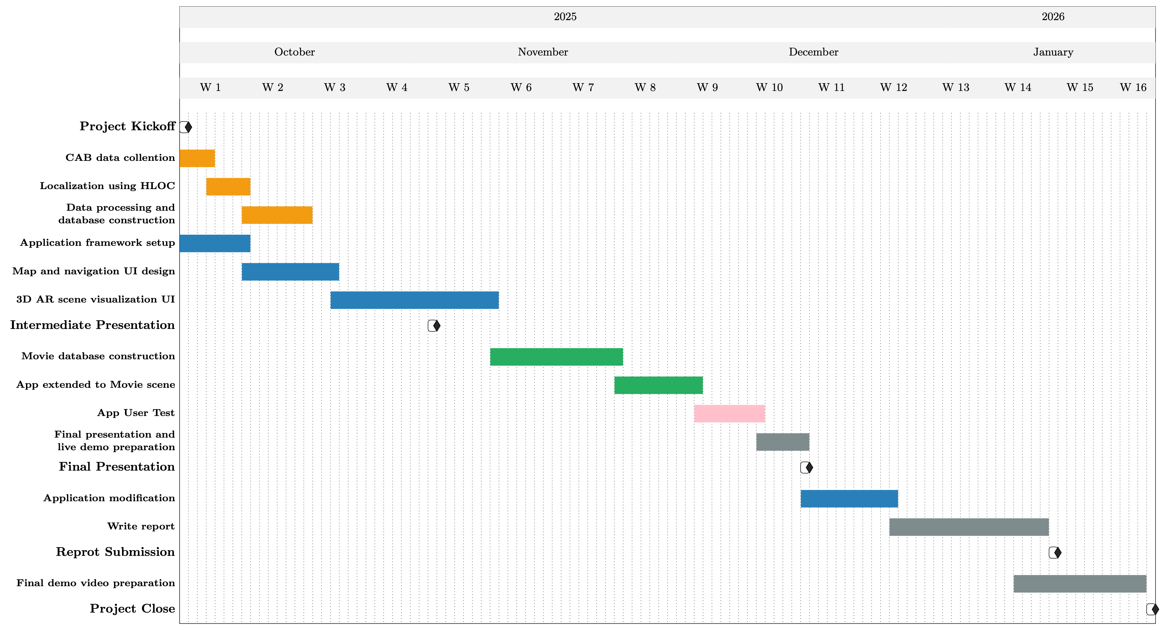
Timeline
√
√
√
√
In progress
In progress
Integrate offline algorithm and app
Notes:
The timeline summarizes our progress this semester. We have completed data collection, localization with HLOC, and database setup.
Currently, we are integrating the offline localization algorithm with the Unity AR app, developing real-time 3D visualization.
The next steps include extending the app to movie scenes, user testing, and preparing for the final presentation.

Slide 5
Q & A

